Slide 1
beam line optimization for laser-accelerated ions

Slide 2
AgenDa
1 The LIGHT experiment setup
2 Target normal sheath acceleration
3 Optimization model
4 SIS18 Injection
5 Conclusion and future development

Slide 3
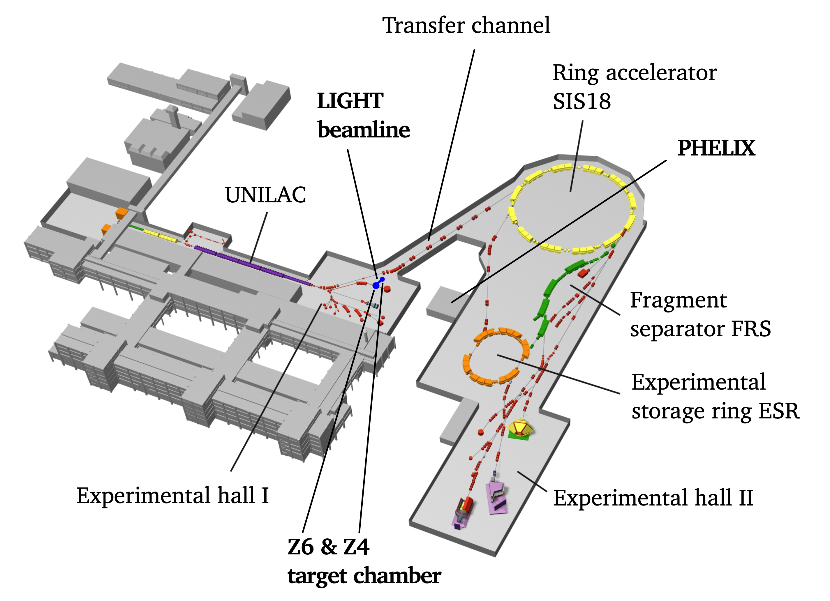
The light experiment setup
Injection point
Notes:
Blue dot is the Z6 target chamber where laser accelerated ions are “produced” using the PHELIX laser
Aim is to feed laser accelerated ions into the SIS18 via the transfer channel (TC)
Reaching the TC the beam will still pass some transport/shaping elements like cavities or quadrupoles so there is some freedom in the choice (within some acceptance limits of the TC) of particle ensembles -> provided we can increase the transmission for example

Slide 4
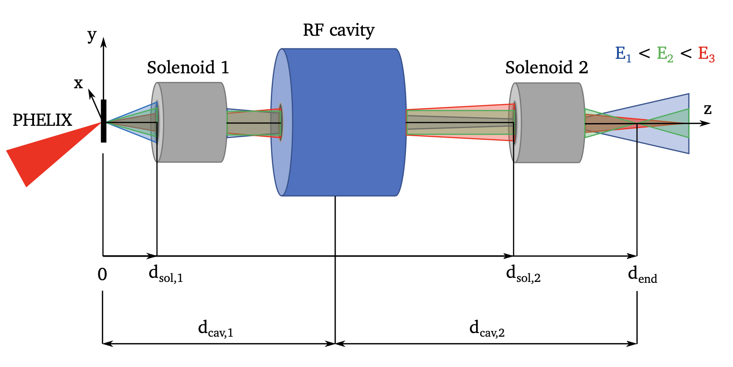
The light experiment setup (z6)
currently a high-fidelity Runge-Kutta fieldmap tracker is used
beam line setup is done manually or by using parameter sweeps
so far, no optimization scheme has been implemented for this experiment
other attempts use simplified, specialized and idealized models and limited parameters (e.g. quadrupole currents but fixed distances, drift distances but fixed permanent magnet field)
robustness and accuracy of the optimization point is rarely addressed
M. Metternich, Shaping of laser-accelerated ion beams for applications in high energy density physics (2023)
Notes:
Solenoid acts as magnetic lens (similar to optic lenses) where the focus is controlled by the current (proportionally related to B-field)
Cavity uses a standing (TM) wave to accelerate (or decelerate) specific particles

Slide 5
Beamline elements
Cavity
uses a standing wave to accelerate particles
is typically built for a reference particle energy – fixed frequency
in this case used for a phase rotation in the longitudinal phase space
Solenoid
a solenoid acts similarly to an optical lens, rotationally symmetric w.r.t. the z-axis
focal point is controlled by the current (proportional to B-field)
impacts the transverse components of the beam

Slide 6
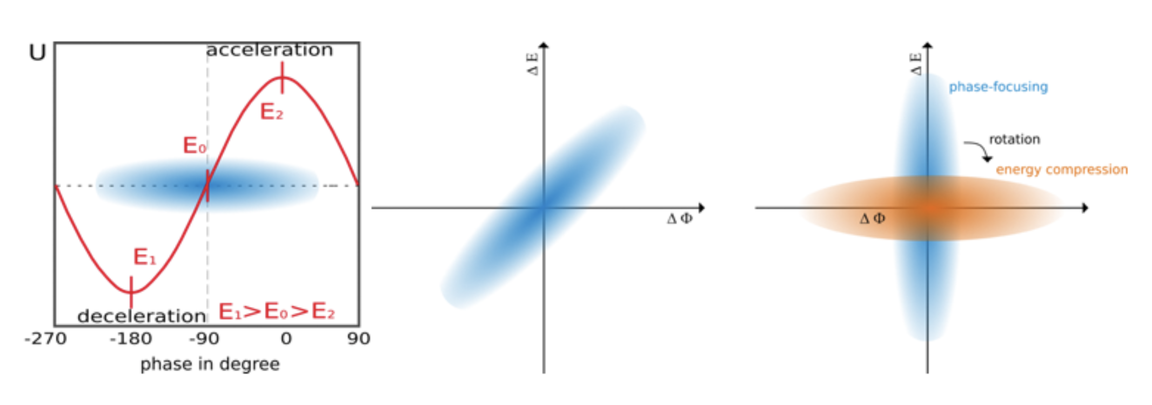
Beamline elements
Cavity energy compression
https://www.gsi.de/work/forschung/appamml/plasmaphysikphelix/experimente/light

Slide 7
AgenDa
1 The LIGHT experiment setup
2 Target normal sheath acceleration
3 Optimization model
4 SIS18 Injection
5 Conclusion and future development

Slide 8
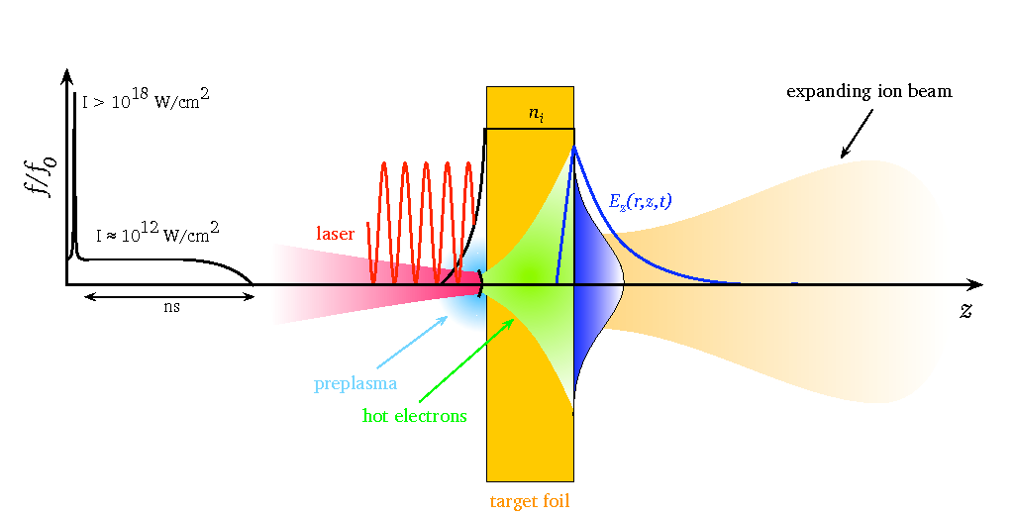
Target normal Sheath Acceleration
M. Roth, M. Schollmeier, CAS, 105170, (2016)
Notes:
Laser pre-pulse generating plasma on target front (laser) side
Laser intensity have since then (image) increased. ELI-NP 10^23-10^24 regime, PHELIX 2*10^21 W/cm^2
Electrons are accelerated by the laser main pulse into the target under divergence angle
Electrons leave rear side of the target where they create an electron “sheath” leading to a charge separation and electric field (TV/m regime)
This electric field accelerates the ions from the plasma surface
A lot of research going into laser parameters (pulse-shaping:pre ramps, polarization…) as well as targets to modify the characteristics of TNSA

Slide 9
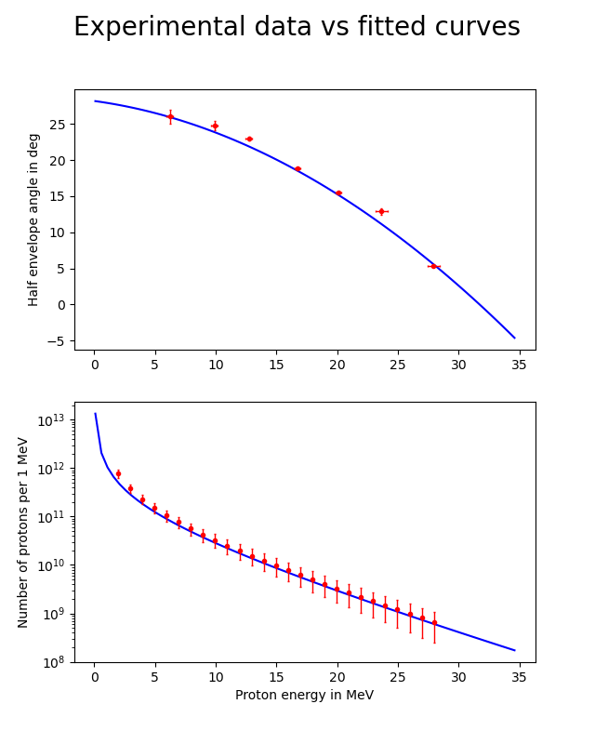
particle distribution
Kinetic energy in MeV

Slide 10
AgenDa
1 The LIGHT experiment setup
2 Target normal sheath acceleration
3 Optimization model
4 SIS18 Injection
5 Conclusion and future development

Slide 11
optimization model
TNSA particle
distribution
Envelope along
beamline
kinetic energy
deviation
Parameter set:
d_{sol,1}, i₁, …
Notes:
This leads to a model with a (for the first step) fixed bunch input which can then be optimized wrt. its output using the parameters

Slide 12
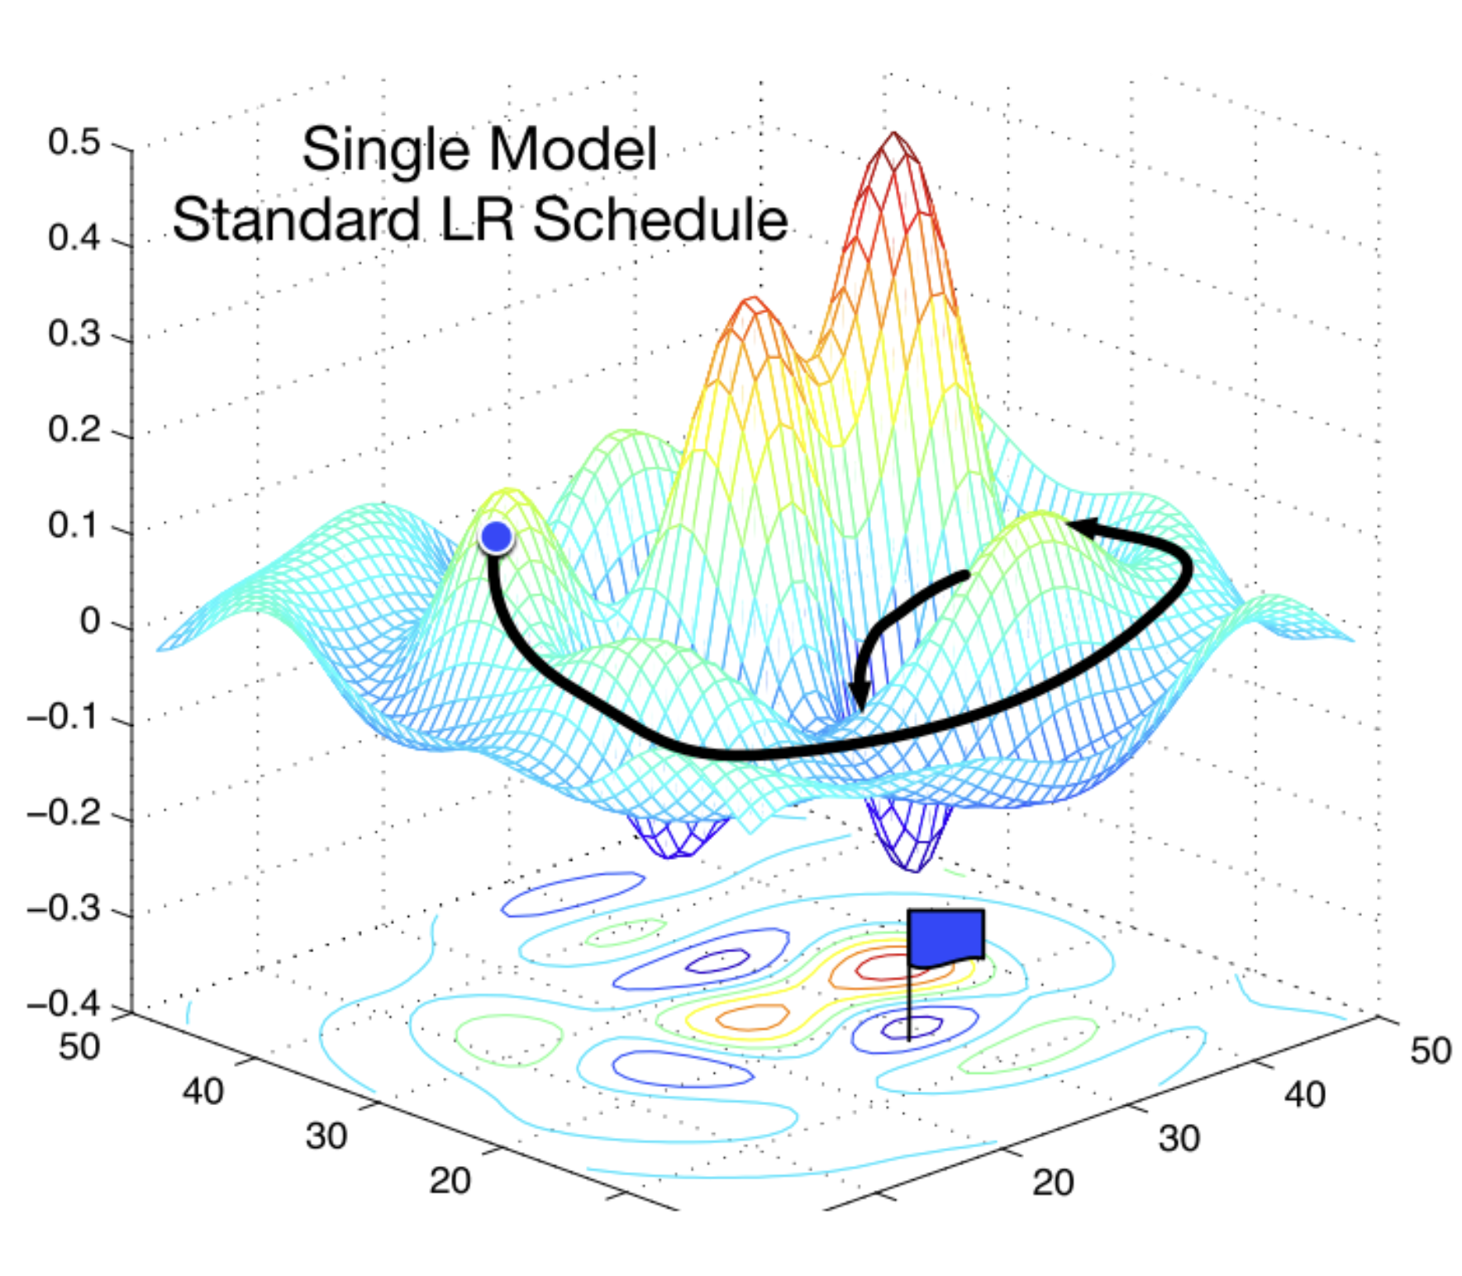
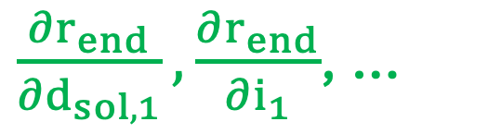
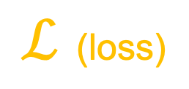
optimization model
$ℒ$ (loss)
TNSA particle
distribution
Envelope along
beamline
kinetic energy
deviation
Parameter set:
d_{sol,1}, i₁, …
$\frac{∂r_{end}}{∂d_{sol,1}},\frac{∂r_{end}}{∂i_{1}}$, …
Notes:
We now define the output as a loss function
each output characteristic is weighted and they are all added together
gradients, linking the parameters to the loss function are computed automatically using autograd
optimizer then uses gradients to find a (local) minimum for the loss function in the parameter hyperspace

Slide 13
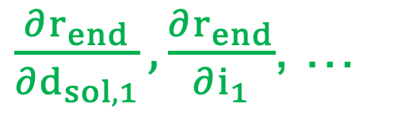
optimization model
$ℒ$ (loss)
TNSA particle
distribution
Envelope along
beamline
kinetic energy
deviation
Parameter set:
d_{sol,1}, i₁, …
$\frac{∂r_{end}}{∂d_{sol,1}},\frac{∂r_{end}}{∂i_{1}}$, …
Beamline model must be
back-propagatable!
Notes:
BUT the model has to be back-propagatable
this rules out pic simulations, and most models using field maps (to some degree) or inplace operations

Slide 14
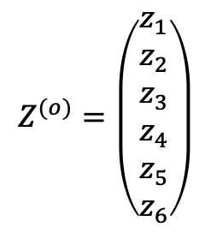
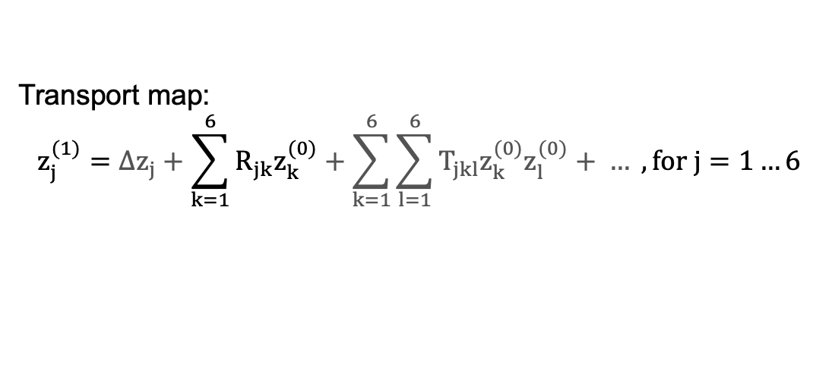


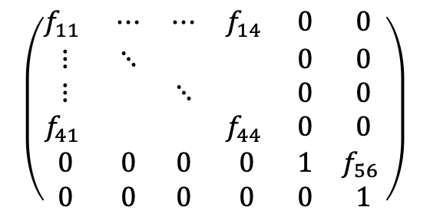
particle tracking using maps
First order map (TPS, truncated power series) for a hard-edge model of a solenoid
$$\left(\begin{matrix}f_{11} & ⋯ & ⋯ & f_{14} & 0 & 0 \\ ⋮ & ⋱ & & & 0 & 0 \\ ⋮ & & ⋱ & & 0 & 0 \\ f_{41} & & & f_{44} & 0 & 0 \\ 0 & 0 & 0 & 0 & 1 & f_{56} \\ 0 & 0 & 0 & 0 & 0 & 1\end{matrix}\right)$$
$$f_{nm}(B, L, β_{s})$$
$$Z^{(o)}=\left(\begin{matrix}z_{1} \\ z_{2} \\ z_{3} \\ z_{4} \\ z_{5} \\ z_{6}\end{matrix}\right)$$
$$Z^{(1)}$$
R
Transport map:
$$z_{j}^{(1)}=∆z_{j}+\sum_{k=1}^{6}{R_{jk}z_{k}^{(0)}+\sum_{k=1}^{6}{\sum_{l=1}^{6}{T_{jkl}z_{k}^{(0)}z_{l}^{(0)}}+ …}} , for j=1…6$$
Notes:
Mapping is done by ”mapping” an incoming particle to its respective output behind the element
In this case second order maps were used for the solenoid
All operations are vector/tensor operations (using einsum in pytorch this is only one line of code!) making this very fast and most importantly back-propagatable
One full simulation run (2 solenoid and 1 cavity) takes about 400 ms (depending on matrix fragmentation)

Slide 15
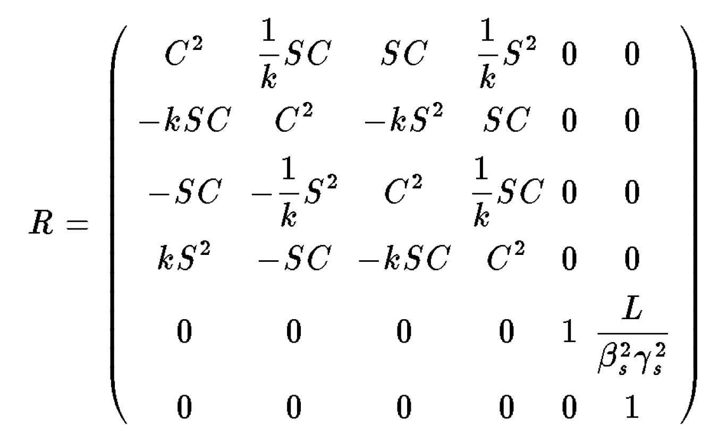


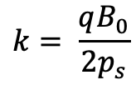



Solenoid model
sparse, rank 3 tensor
$$k= \frac{qB_{0}}{2p_{s}}$$
$$C=\cos{(kL)}$$
$$S=\sin{(kL)}$$
M
R =
T =
$$Z^{(o)}$$
$$Z^{(1)}$$
$$z_{j}^{(1)}=∆z_{j}+\sum_{k=1}^{6}{R_{jk}z_{k}^{(0)}+\sum_{k=1}^{6}{\sum_{l=1}^{6}{T_{jkl}z_{k}^{(0)}z_{l}^{(0)}}}}$$
F. Christoph Iselin, MAD Physical Methods Manual
https://mad8.web.cern.ch/doc/phys_guide.pdf
Notes:
Mapping is done by ”mapping” an incoming particle to its respective output behind the element
In this case second order maps were used for the solenoid
All operations are vector/tensor operations (using einsum in pytorch this is only one line of code!) making this very fast and most importantly back-propagatable
One full simulation run (2 solenoid and 1 cavity) takes about 400 ms (depending on matrix fragmentation)

Slide 16

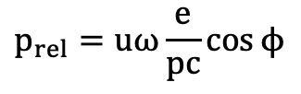
Cavity model
u
similar to the solenoid model the cavity model is also divided into n segments
every segment provides a voltage “kick” of u/n where u is the cavity voltage
t
$$p_{rel}=uω\frac{e}{pc}\cos{ϕ}$$
$$ϕ=ϕ_{s}−2πf\frac{t}{c}$$

Slide 17
Gradient based optimization
$ℒ$ (loss)
TNSA particle
distribution
Envelope along
beamline
kinetic energy
deviation
Parameter set:
d_{sol,1}, i₁, …
$\frac{∂r_{end}}{∂d_{sol,1}},\frac{∂r_{end}}{∂i_{1}}$, …
Notes:
BUT the model has to be back-propagatable
this rules out pic simulations, and most models using field maps (to some degree) or inplace operations

Slide 18

optimization problem
Define as optimization problem:
$$P: \min_{Θ}{ℒ\left(Θ\right)}, Θ∈M$$
With the parameter vector:
$$Θ=(i_{1}, i_{2}, d_{1}, d_{2},u,ϕ)$$
Subject to:
$$M=\left\{Θ∈ℝ^{6} | \begin{aligned}0≤i_{1}, i_{2}≤i_{max} \\ &0≤d_{1}, d_{2} \\ 0≤d_{1}+d_{2}≤z_{max}−l_{elements} \\ 0≤u≤u_{max}\end{aligned}\right.$$

Slide 19
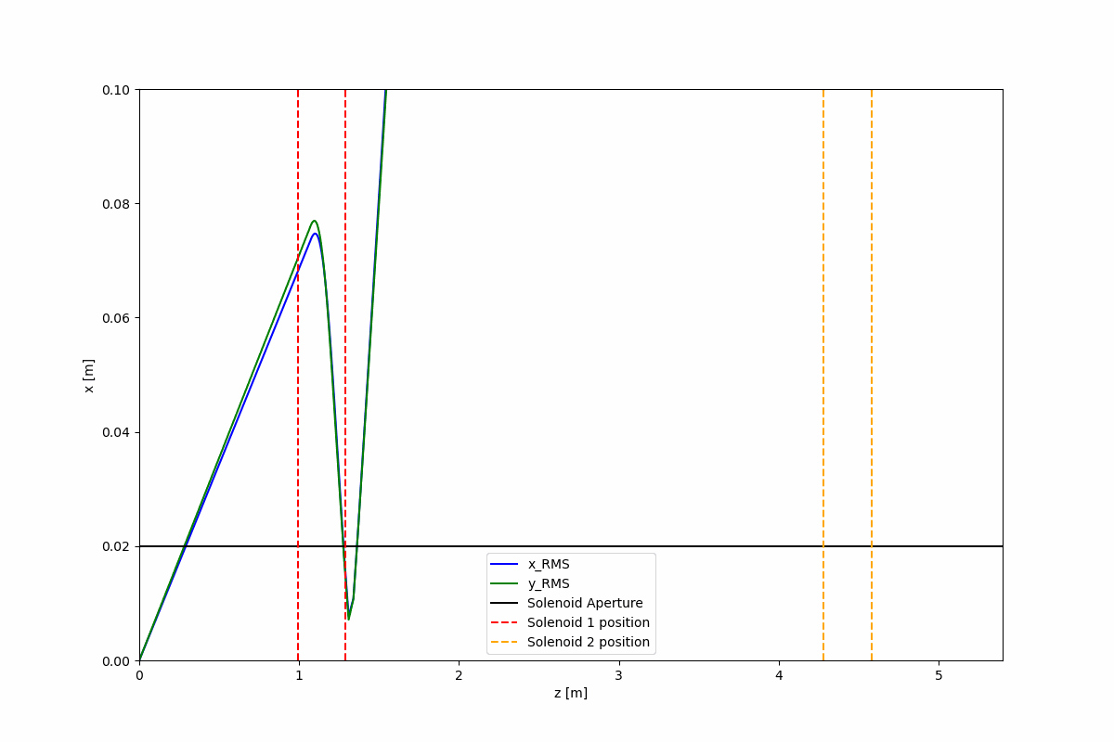
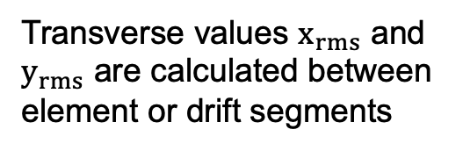
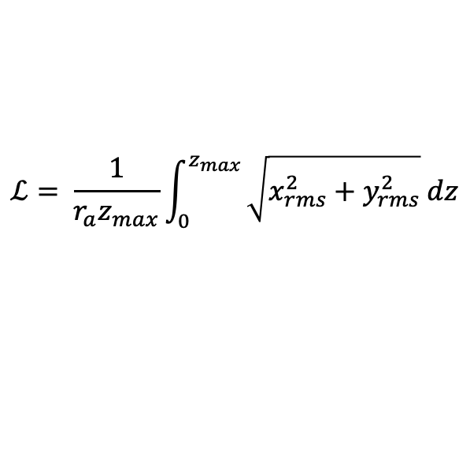
Optimization using only solenoids
Particle distribution:
- 7 – 9 MeV protons
- 140 mrad initial divergence
Transverse values $x_{rms}$ and $y_{rms}$ are calculated between element or drift segments
Loss function:
$$ℒ= \frac{1}{{r_{a}z}_{max}}\int_{0}^{z_{max}}{\sqrt{x_{rms}^{2}+y_{rms}^{2}} dz}$$
Optimizer quickly (400 μs per iteration) finds a minimum for the envelope by shifting the solenoid positions and adjusting the currents
Notes:
419 particles make it through

Slide 20
kinetic energy distribution
If left unchecked energy distribution remains wide which makes the transport down the line difficult or the injection into SIS18 unfeasable.
Solution:
Include cavity and include energy deviation to loss function

Slide 21
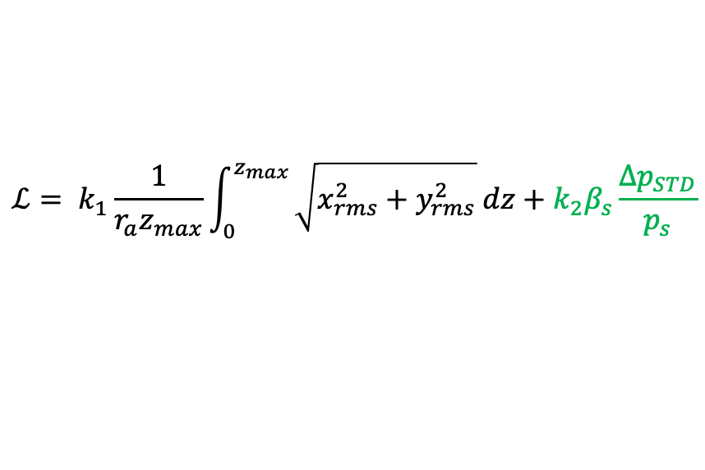
kinetic energy distribution
$$ℒ= k_{1}\frac{1}{{r_{a}z}_{max}}\int_{0}^{z_{max}}{\sqrt{x_{rms}^{2}+y_{rms}^{2}} dz}+k_{2}β_{s}\frac{Δp_{STD}}{p_{s}}$$
Notes:
better/less energy deviation but slightly worse transmission – only 398

Slide 22
Comparison to high fidelity model
Using a 9… 11 MeV particle ensemble of 1000 protons
140 mrad initial divergence
Parameters are solenoid currents, cavity voltage and phase, and distance between first solenoid and cavity, cavity and second solenoid
Distance between first solenoid and target is fixed at the technical minimum of about 4 cm
Notes:
Every optimization showed that the solenoid should be as close as possible to the target which is 4 cm

Slide 23
Comparison to high fidelity model
Using a 9… 11 MeV particle ensemble of 1000 protons
140 mrad initial divergence
Parameters are solenoid currents, cavity voltage and phase, and distance between first solenoid and cavity, cavity and second solenoid
Distance between first solenoid and target is fixed at the technical minimum of about 4 cm
 | i₁ [kA] | i₂ [kA] | d1 [m] | d2 [m] | u_{cav} [MV] | Φ_{cav} [rad]
Parameters | 9.3 | 4 | 0.7 | 1.1 | 0.5 | 1.5

Slide 24
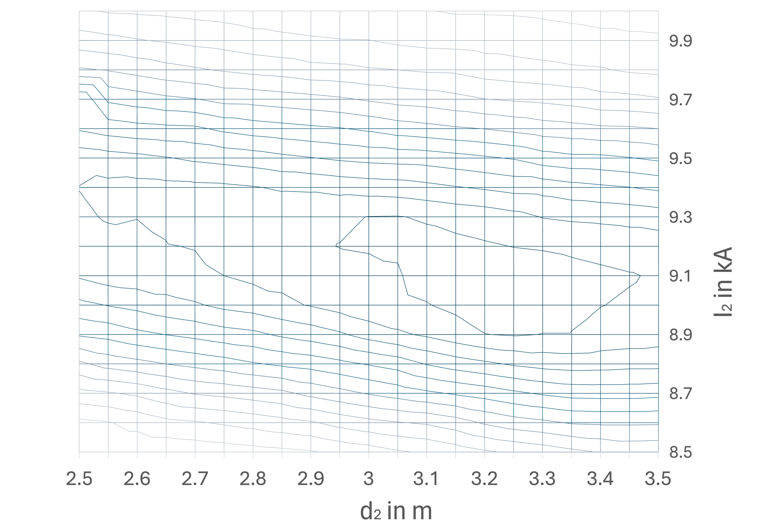
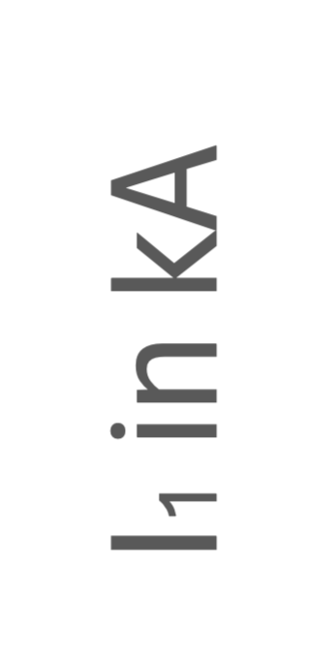
Comparison to high fidelity model
60 – 65 % transmission
Possible errors due to:
solenoid model – 3rd order, spherical aberrations
geometric errors – exact solenoidal coil positions
the loss function also minimizes the energy spread
65 – 70 % transmission
predicted optimum
Notes:
3D transmission (contour) map generated with RK Tracker using parameter sweep
errors hint towards an error caused by deviations from the exact geometry of the components:
- solenoid fieldmaps are 500 mm long for a 300 mm solenoid
- exact position of the coil withing the solenoid can only be guessed, so was assumed to be centered within the housing
- optimizer minimizes for energy spread as well, not only transmission/beam size (this might be the most important point) meaning that this might be due to a trade-off between transmission and energy spread

Slide 25
Comparison to high fidelity model
Using a 4… 6 MeV particle ensemble of 1000 protons
140 mrad initial divergence
Parameters are solenoid currents, cavity voltage and phase, and distance between first solenoid and cavity, cavity and second solenoid
Distance between first solenoid and target is fixed at the technical minimum of about 4 cm
 | i₁ [kA] | i₂ [kA] | d1 [m] | d2 [m] | u_{cav} [MV] | Φ_{cav} [rad]
Parameters | 6.5 | 2.6 | 0.2* | 1.5 | 0.4 | 1.5
Notes:
contrasted to the faster 9… 11 MeV bunch these particles travel slower and have a bigger longitudinal spread than when reaching the cavity. model tries to compensate by moving the cavity as close as possible to the source which is limited by the first solenoid
0.2 was chosen here because the fieldmap in the RK tracker is 500 mm long as opposed to the mapping method with 300 mm
All gradients x 1e5

Slide 26
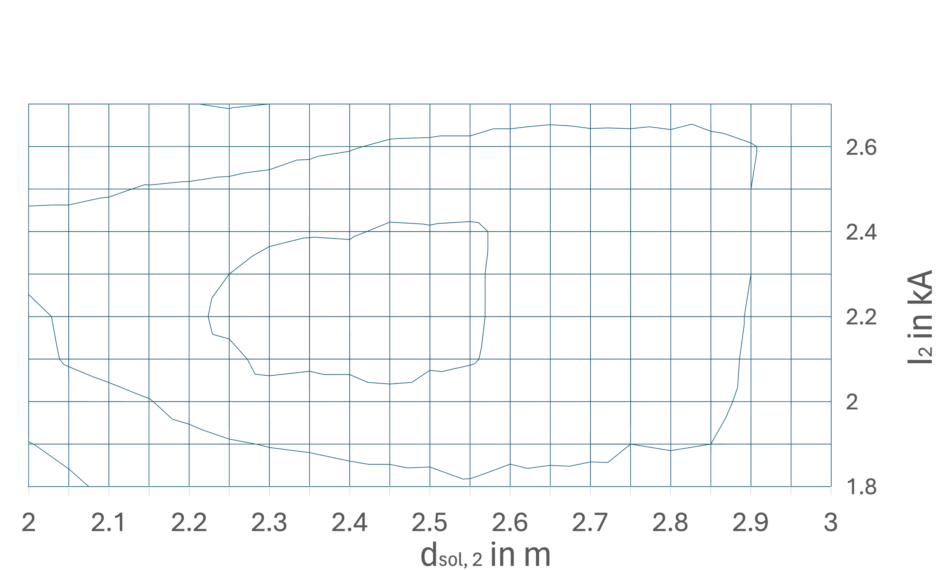
Comparison to high fidelity model
45 – 50 % transmission
40 – 45 % transmission
predicted optimum
overall model has a small current offset for the solenoid
can still predict optimal operating points with up to 5 – 10 % accuracy with regards to transmission
Notes:
same procedure as before, parameter sweep now only over parameters of the second solenoid since these were shown to be most sensible towards transmission
current seems to have a constant offset, hinting at a systematic error

Slide 27
AgenDa
1 The LIGHT experiment setup
2 Target normal sheath acceleration
3 Optimization model
4 SIS18 Injection
5 Conclusion and future development

Slide 28
Back to TNSA – short recap
Kinetic energy in MeV
Notes:
This is not a trivial question since the TNSA spectrum follows an exponential function meaning that low energy protons are vastly overrepresented
However they also show a much higher divergence angle making their focus more challenging
also the cavity is not designed for this energy, frequency and overall experiment geometry are rather optimized for 5-10 MeV protons: slow protons will “debunch” more longitudinally and will have a higher longitudinal spread, not optimal for the cavity frequency
-> there is a tradeoff between a higher particle density in lower energy regions and system compatibility

Slide 29
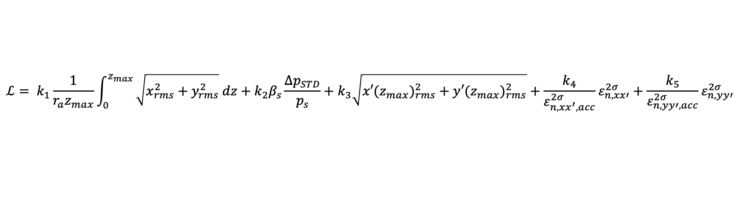
SIS18 injection
x’
x
1. Use optimizer to find optimal parameters to shape a beam for SIS18 injection
  Expand the loss function by desired characteristics
  optimize using reference beam (9 – 14 MeV)
2. Run high fidelity field tracker to check the transmission of viable particles
$$ℒ= k_{1}\frac{1}{{r_{a}z}_{max}}\int_{0}^{z_{max}}{\sqrt{x_{rms}^{2}+y_{rms}^{2}} dz}+k_{2}β_{s}\frac{Δp_{STD}}{p_{s}}+k_{3}\sqrt{{x′(z_{max})}_{rms}^{2}+{y′(z_{max})}_{rms}^{2}}+\frac{k_{4}}{ε_{n, xx^{′},acc}^{2σ}}ε_{n, xx′}^{2σ}+\frac{k_{5}}{ε_{n, yy′,acc}^{2σ}}ε_{n, yy′}^{2σ}$$
envelope
momentum
gradient at z_{max}
emittances

Slide 30
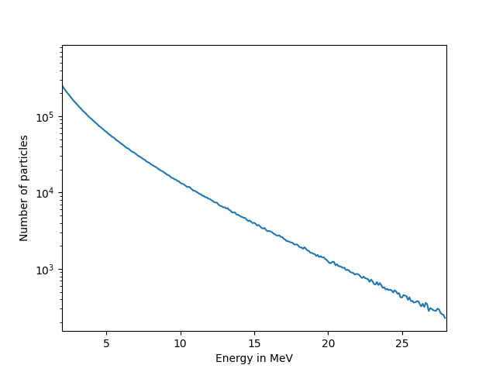
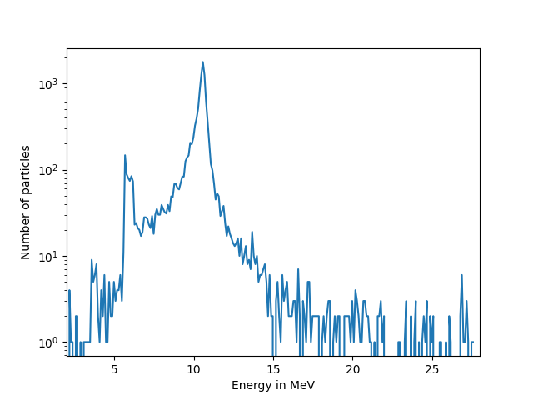
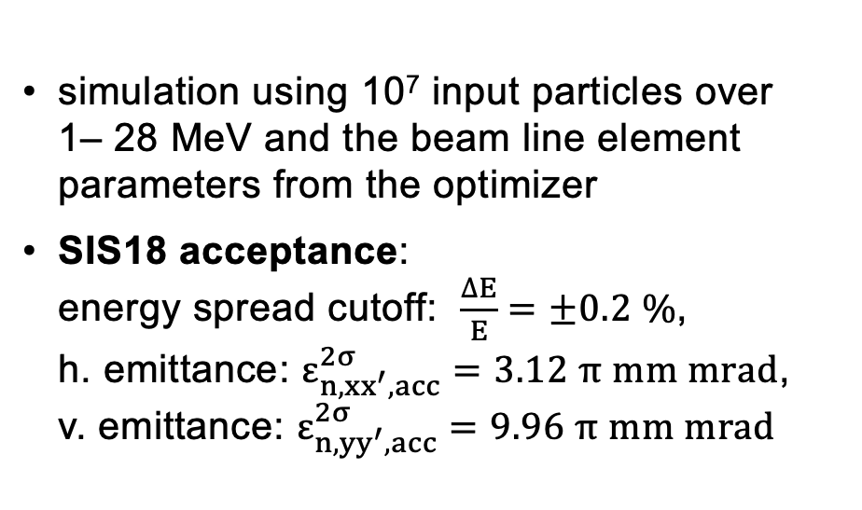
SIS18 injection
x’
x
energy spread cutoff
simulation using 10⁷ input particles over
1– 28 MeV and the beam line element parameters from the optimizer
SIS18 acceptance:
energy spread cutoff: $\frac{∆E}{E}=±0.2 \%$,
h. emittance: $ε_{n, xx^{′},acc}^{2σ}=3.12 π mm mrad$,
v. emittance: $ε_{n, yy^{′},acc}^{2σ}=9.96 π mm mrad$
input bunch
output bunch @ z_{max}

Slide 31
SIS18 injection
scaled up to a full TNSA spectrum this leads to a bunch in the mid range of 10⁸ (after cutoff) that could be injected into SIS18
compared with simulations done by LIGHT group: 3.2 x 10⁸ particles
goal is to increase this to 10⁹ – 10¹⁰ particle range
energy spread cutoff
input bunch
output bunch @ z_{max}
Notes:
This can be improved by:
improving the element models to predict more accurate parameters for loss minima
compare to alternative elements such as quadrupole duplet or plasma lens
add elements such as a cavity (tradeoff between acceleration and phase rotation for wide energy spectra)
first cavity to accelerate and perform minor phase rotation, second cavity only for energy compression (phase rotation)

Slide 32
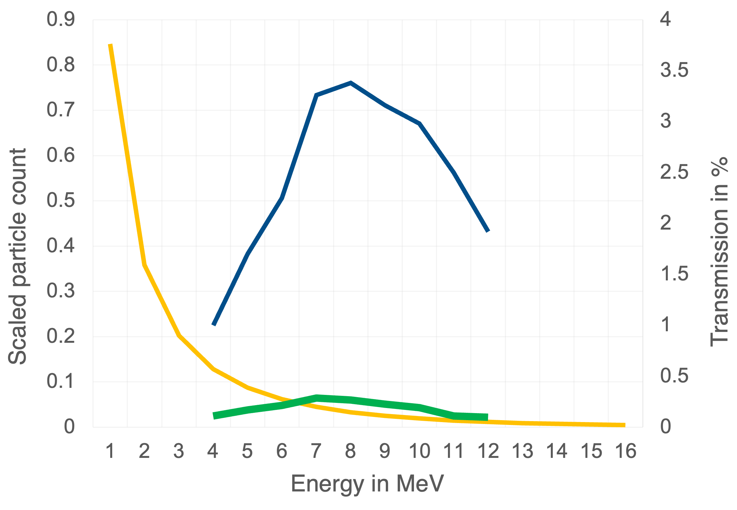
SIS18 injection – optimal energy
evaluated optimized transmission (blue) over different reference energies
scaled (to 1) particle spectrum (orange)
scaled particle output (green)
TNSA particle
spectrum
transmission
scaled particle
output

Slide 33
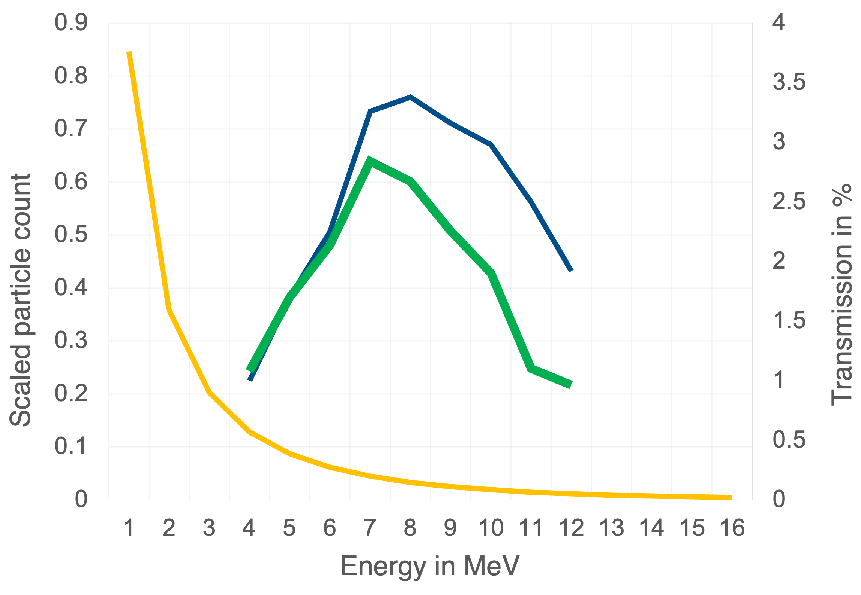
SIS18 injection – optimal energy
evaluated optimized transmission (blue) over different reference energies
scaled (to 1) particle spectrum (orange)
scaled particle output (green) x 10
overall transmission is optimal at 8 MeV
scaling by TNSA particle spectrum leads to an optimal energy of 7 – 8 MeV
which is „coincidentally“ the nominal particle energy for the 3-gap cavity
energy compression and thus the cavity is the bottleneck for the current setup
TNSA particle
spectrum
transmission
scaled particle
output x 10

Slide 34
conclusion
model is able to predict optimal operating points
current setup peaks at bunches with about 10⁸ protons
the first capturing element and the cavity are the limiting factors for the emittance and energy deviation respectively
Notes:
If a valid model laser parameters to TNSA distribution is developed it could be incorporated into this optimization scheme (if it is back-propagatable like for example a neural network) allowing to also optimize laser parameters together with the actual beam line parameters

Slide 35
outlook
map improvement by adding higher order maps, map training
inclusion of other elements such as quadrupole duplets or plasma lenses
shot to shot robustness of optimized operating points
design studies on ideal/optimized beamline elements (e.g. voltage profile/frequency of the cavity)
alignment optimization by radiochromatic film stack reconstruction
Notes:
If a valid model laser parameters to TNSA distribution is developed it could be incorporated into this optimization scheme (if it is back-propagatable like for example a neural network) allowing to also optimize laser parameters together with the actual beam line parameters

Slide 36

ACKNOWLEDGEMENTS
Supervisor: Oliver Boine-Frankenheim
Co-Supervisor: Catalin Ticoș
This work is supported by the Deutsche Forschungsgemeinschaft (DFG, German Research Foundation) – Project-ID 499256822 – GRK 2891 'Nuclear Photonics'.

Slide 37
Expanded Beamline
different phase shift (relative to 11.4 MeV) than
around 1.5 rad as before
Target (0 mm)
Cavity 1
Cavity 2
Solenoid 1
Solenoid 2
u = 2 kV
u = 0.9 kV
i = 9.3 kA
Φ = 1.1 rad
Φ = 3.1 rad
i = 2.2 kA
40 mm
1225 mm
2075 mm
2650 mm

Slide 38
Expanded Beamline – Energy gain
!
Unusual operating point
for the second cavity
Energy gain from first cavity
Energy gain from second cavity
Resulting energy gain
Notes:
Chosing these phase shifts for the cavities would have been hard or counterintuitive but the optimizer finds the best combination

Slide 39
Expanded Beamline – Energy gain
asymmetric phase rotation with
energy boost for lower energies
ideal compression
around 11.4 MeV
Energy gain using 2 cavities
Energy gain using 1 cavity
Notes:
Energy gain through cavity(cavities) on y-axis and initial energy on x-axis with divergence angle

Slide 40
Expanded Beamline – Results
optimizer switches from pure energy compression to compromise between compression and acceleration of lower energies when using two cavities
focus lies on lower energy particles because of higher yield
this boosts transmission from 1-2 % to about
5 % for energy range of 9 – 14 MeV
particles viable for SIS18 injection now in the lower range of 10⁹.
Energy gain using 2 cavities

Slide 41
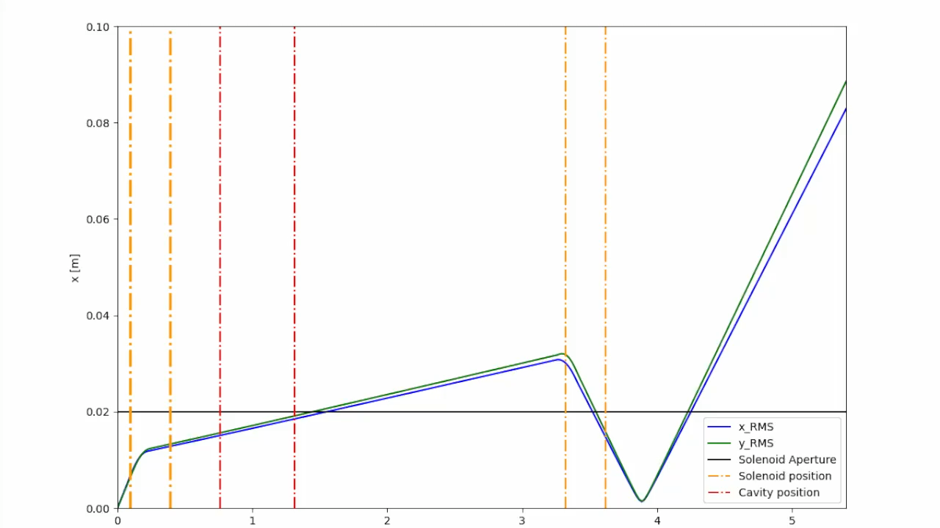
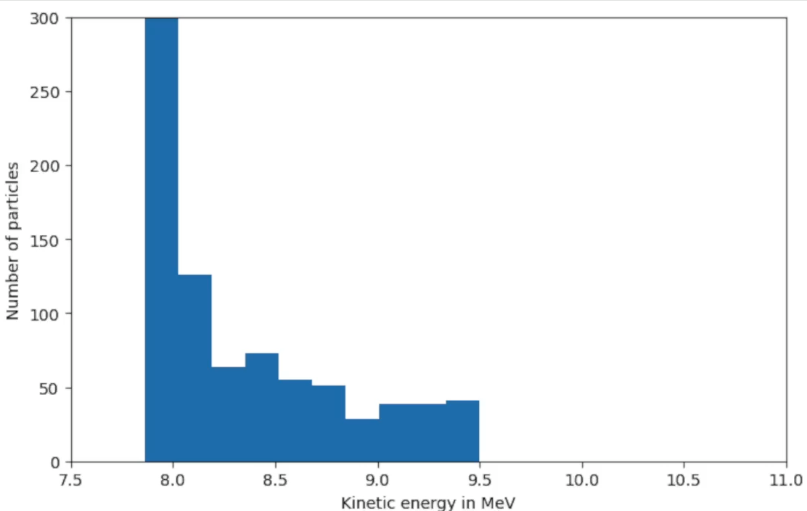
Result after loss function expansion
Notes:
Left side shows the model optimizing the beam envelope (as seen before)
But now the kinetic energy spread is also optimized as seen on the right side
So the optimization works but how valid are the optimization results

Slide 42
Solenoid Acceptance
target
$$\frac{r_{s}}{d_{s}+L/2}=\tan{γ}$$
beam
r_{s}
$$γ≈ \tan^{−1}\left(\frac{20}{40+150}\right)$$
$$γ$$
$$γ≈6°$$
d_{s} + L/2
solenoid

Slide 43
Energy Filtering
$$f_{min}=\frac{r_{s}}{r_{s}+r_{a}}\left(\frac{L_{s}}{2}+l_{d}+L_{a}\right)$$
$f_{max}=$ $\frac{r_{s}}{r_{s}−r_{a}}\left(\frac{L_{s}}{2}+l_{d}\right)$
$$∆f$$
L_{a}
r_{s}
L_{s}
r_{a}
aperture
l_{d}
$$f_{min}(E_{min})$$
$$f_{max}(E_{max})$$
solenoid
Notes:
Specific numbers from LIGHT experiment: Ls = 300 mm, rs = 20 mm, La = 550 mm, ra = 17.5 mm, ld = 1700 mm
This leads to fmin = 1.3 m and fmax = 15.1 m.
Using simulations energy band of 10… 11.9 MeV was determined since relation between kinetic energy and focal length cannot be (accurately) be calculated. Factor alpha is dependent on magnetic field and geometry.

Slide 44
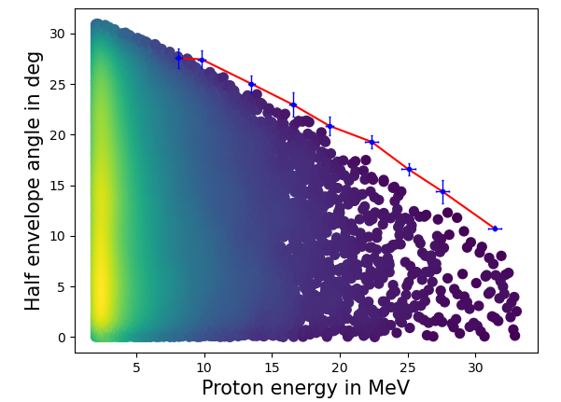
$$E_{min}\left(f_{min}=\frac{r_{s}}{r_{s}+r_{a}}\left(\frac{L_{s}}{2}+l_{d}+L_{a}\right)\right)$$
$$E_{max}\left(f_{max}=\frac{r_{s}}{r_{s}−r_{a}}\left(\frac{L_{s}}{2}+l_{d}\right)\right)$$
$${γ_{max}=tan}^{−1}\frac{r_{s}}{d_{s}+L/2}$$
$$B_{sol}$$
Notes:
- transmission is more or less predetermined by the geometry and initial distribution
- solenoid can only select the specific energy interval

Slide 45
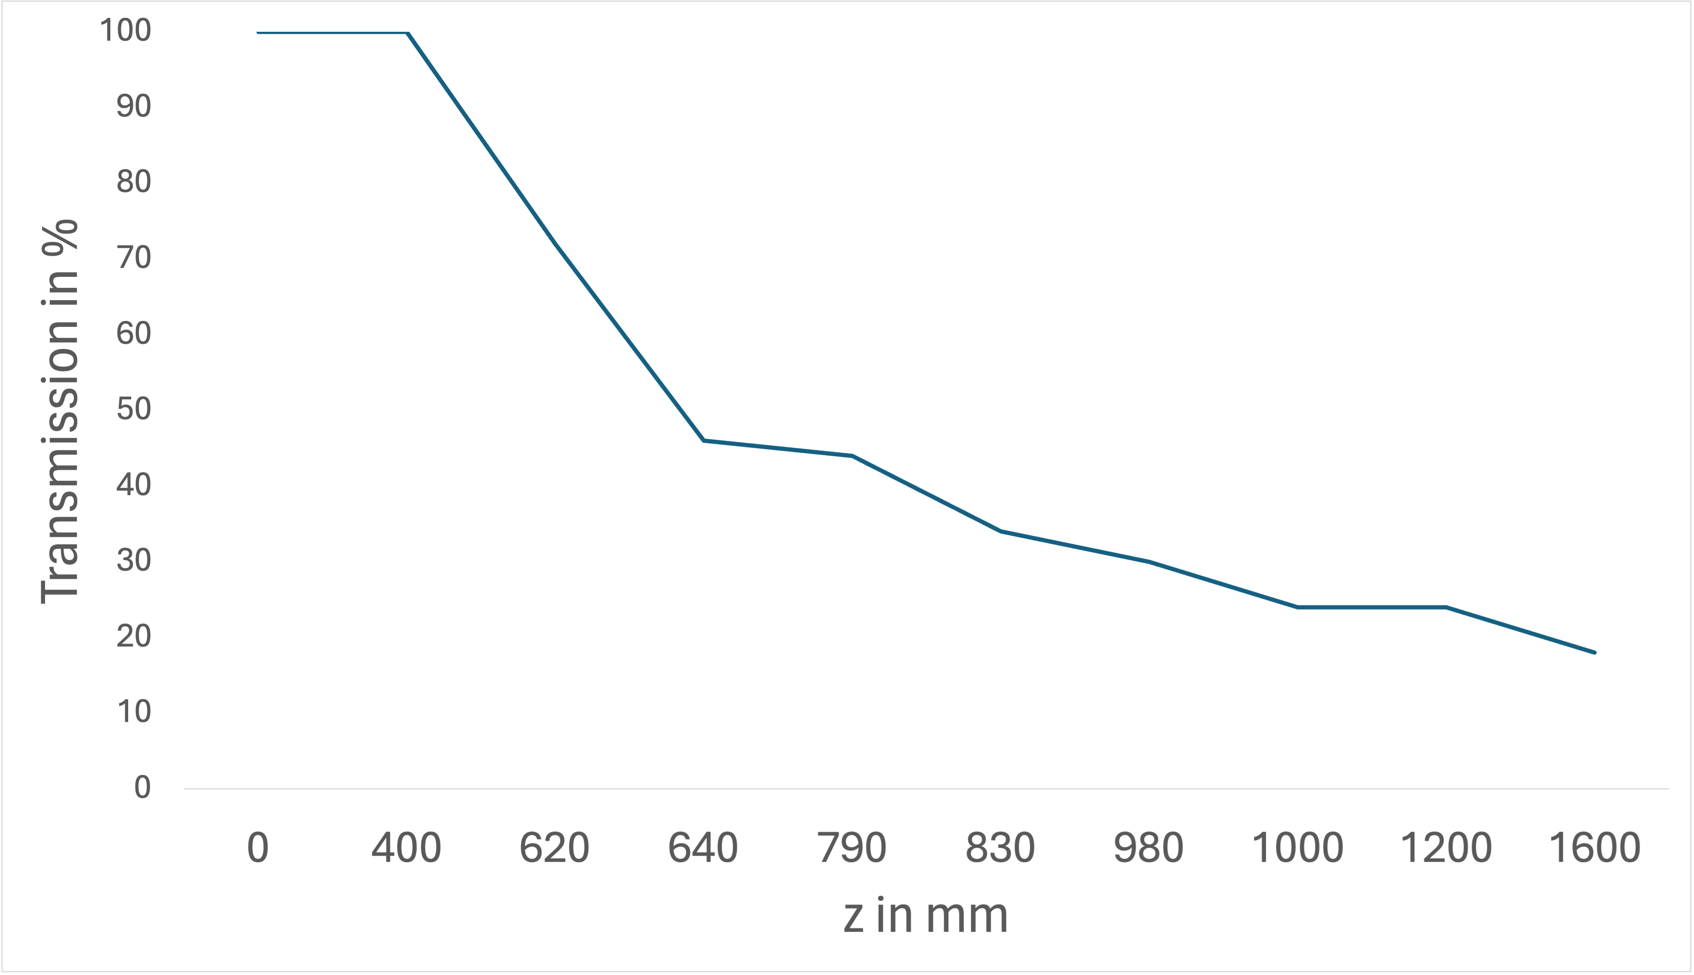

Full spectrum analysis – Transmission map
$$>140 mrad$$
S1
S2
C1

Slide 46
Transmission and Emittance
Overall, this leads to a transmission (from target to aperture exit)
$t≈0.1…1 \%$
What about the emittance?

Slide 47
Energy Filtering
$$f_{max}$$
$$f_{min}$$
$$Ω_{max}$$
$$Ω_{min}$$
aperture
$$ε_{max}≈π{ Ω}_{max}{ r}_{a}$$
solenoid

Slide 48
Transmission and Emittance
Overall, this leads to a transmission (from target to aperture exit)
$t≈0.5…1 \%$
What about the emittance?
$$ε_{n(8 MeV),max}≈1.9 π mm mrad$$
TK/SIS18 acceptance:
$$ε_{n(8 MeV),max}≈2.86 π mm mrad$$
Notes:
Transmission depending on considered distribution and specific energy interval. For the calculation above different intervals between 8 and 12 MeV were considered

Slide 49
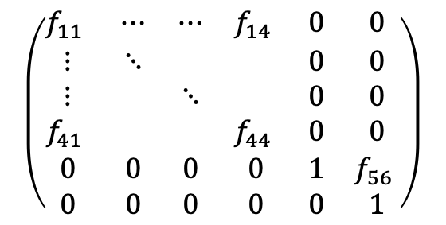
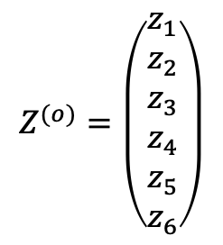


On Using Transport Map Segments
Consider a first order map for a hard-edge model of a solenoid
$$f_{nm}(B, L, β_{s})$$
$$\left(\begin{matrix}f_{11} & ⋯ & ⋯ & f_{14} & 0 & 0 \\ ⋮ & ⋱ & & & 0 & 0 \\ ⋮ & & ⋱ & & 0 & 0 \\ f_{41} & & & f_{44} & 0 & 0 \\ 0 & 0 & 0 & 0 & 1 & f_{56} \\ 0 & 0 & 0 & 0 & 0 & 1\end{matrix}\right)$$
$$Z^{(o)}=\left(\begin{matrix}z_{1} \\ z_{2} \\ z_{3} \\ z_{4} \\ z_{5} \\ z_{6}\end{matrix}\right)$$
$$Z^{(1)}$$
$$Δs/∆t$$

Slide 50





On Using Transport Map Segments
Consider a first order map for a hard-edge model of a solenoid
$$R$$
$$Z^{(o)}$$
$$Z^{(1)}$$
$$B_{z}(s)$$
$$s$$

Slide 51


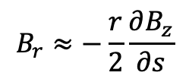


On Using Transport Map Segments
Matrix can be decomposed into two fringe segments (F) surrounding a homogenous section
$$F(B_{r},β_{s})$$
$$H(B_{z}, L, β_{s})$$
$$F^{−1}$$
$$B_{r}≈−\frac{r}{2}\frac{∂B_{z}}{∂s}$$
$$Z^{(o)}$$
$$Z^{(1)}$$
$$B_{z}(s)$$
$${∆B}_{z}$$
$$s$$

Slide 52
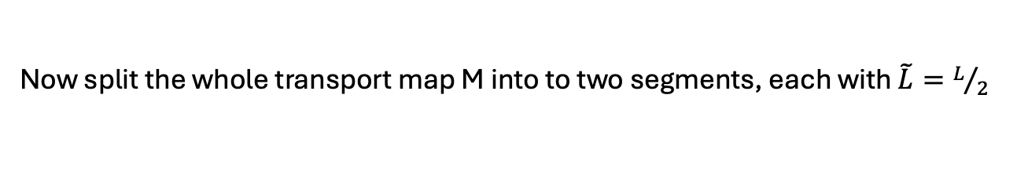



On Using Transport Map Segments
Now split the whole transport map M into to two segments, each with $\tilde{L}=L/2$
$$\tilde{R}$$
$$\tilde{R}$$
$$Z^{(1)}$$
$$Z^{(o)}$$
$$Z^{(2)}$$

Slide 53
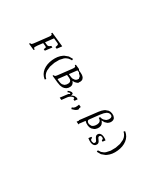

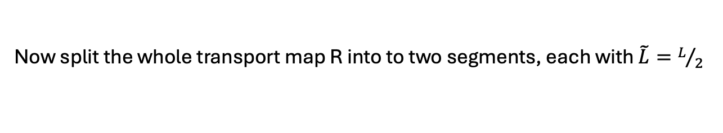
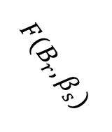



On Using Transport Map Segments
Now split the whole transport map R into to two segments, each with $\tilde{L}=L/2$
$$\tilde{M}(B_{z}, \tilde{L}, β_{s})$$
$$\tilde{M}(B_{z}, \tilde{L}, β_{s})$$
$$Z^{(o)}$$
$$F^{−1}$$
$$F^{−1}$$
$$Z^{(2)}$$
$$F(B_{r},β_{s})$$
$$F(B_{r},β_{s})$$
$$B_{z}(s)$$
$${∆B}_{z}$$
$$s$$

Slide 54

On Using Transport Map Segments
Matrices $F$ and $F^{−1}$ multiply to unity, and the two matrices $\tilde{M}$ multiply to $M$ so in essence nothing changes.
$$\tilde{M}(B_{z}, \tilde{L}, β_{s})$$
$$I$$
$$\tilde{M}(B_{z}, \tilde{L}, β_{s})$$
$$Z^{(o)}$$
$$F^{−1}$$
$$Z^{(1)}$$
$$F(B_{r},β_{s})$$
$$B_{z}(s)$$
$${∆B}_{z}$$
$$s$$

Slide 55

On Using Transport Map Segments
We only gain insight into intermediary phase space vector $Z^{(1)}$ which has a debatable significance/accuracy. BUT…
$$\tilde{M}(B_{z}, \tilde{L}, β_{s})$$
$$\tilde{M}(B_{z}, \tilde{L}, β_{s})$$
$$Z^{(1)}$$
$$Z^{(o)}$$
$$F^{−1}$$
$$Z^{(2)}$$
$$F(B_{r},β_{s})$$
$$B_{z}(s)$$
$${∆B}_{z}$$
$$s$$

Slide 56


On Using Transport Map Segments
What if we increase the number of segments and then use the actual profile of the magnetic field
…
…
…
$$Z^{(i)}$$
$$Z^{(n)}$$
$$B_{z}(s)$$
$$s$$

Slide 57

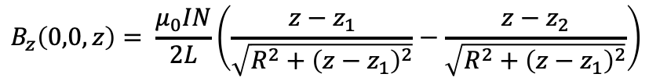
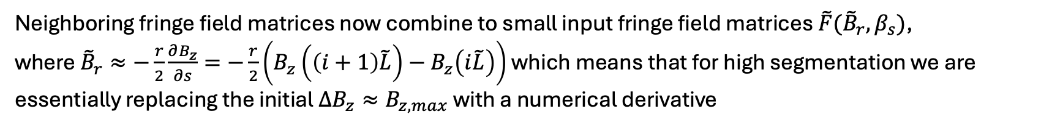


On Using Transport Map Segments
Neighboring fringe field matrices now combine to small input fringe field matrices $\tilde{F}({\tilde{B}}_{r}, β_{s})$,
where ${\tilde{B}}_{r}≈−\frac{r}{2}\frac{∂B_{z}}{∂s}=−\frac{r}{2}\left({B_{z}\left(\left(i+1\right)\tilde{L}\right)−B}_{z}\left(i\tilde{L}\right)\right)$ which means that for high segmentation we are essentially replacing the initial $∆B_{z}≈B_{z, max}$ with a numerical derivative
…
…
…
$$Z^{(i)}$$
$$Z^{(n)}$$
$${\tilde{R}}_{i}(B_{z}(i\tilde{L}),\tilde{L}, β_{s})$$
$${\tilde{R}}_{i+1}$$
$$B_{z}(s)$$
$$B_{z}\left(0,0,z\right)= \frac{μ_{0}IN}{2L}\left(\frac{z−z_{1}}{\sqrt{R^{2}+{\left(z−z_{1}\right)}^{2}}}−\frac{z−z_{2}}{\sqrt{R^{2}+{\left(z−z_{1}\right)}^{2}}}\right)$$
$$s$$
Notes:
Mapping essentially turns into parallel tracking where the only (good) approximation is the radial field. Same approximation is also used in the astra solenoid for example
Potential space charge calculation in between steps?

Slide 58
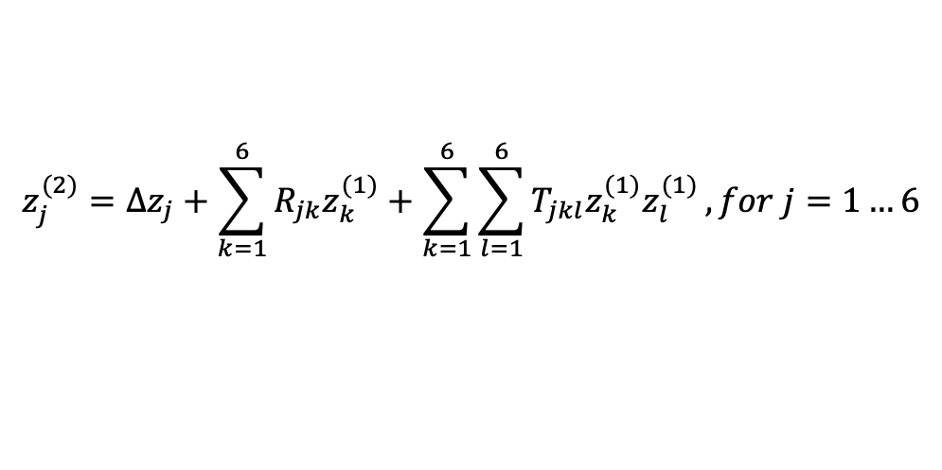
On Using Transport Map Segments
Including the tensor for the second order adds chromatic effects for a solenoid map:
$$z_{j}^{(2)}=∆z_{j}+\sum_{k=1}^{6}{R_{jk}z_{k}^{(1)}+\sum_{k=1}^{6}{\sum_{l=1}^{6}{T_{jkl}z_{k}^{(1)}z_{l}^{(1)}}}}, for j=1…6$$
AND using pytorch all calculations are included on the computational graph which provides all
partial derivatives, from the input parameters (in this case solenoid currents and drift lengths) to
whatever output is required for the loss function (beam size, emittance…)
Additionally, the transport maps are already available for most basic elements and can also be expanded
to the desired order

